Slide 1

Agenda
As of Jan :
Things are changing rapidly. Azure Data Lake Storage Gen2 is in public preview.
Azure Data Lake: What, Why, and How
Data Lake Overview & Use Cases
Big Data in Azure
Data Storage in Azure
Compute in Azure
Integrating Azure Data Lake in a Multi-Platform Architecture
Suggestions for Getting Started with a Data Lake Project

Slide 2
Data Lake
Overview & Use Cases

Slide 3







What is a Data Lake?
Spatial, GPS
Data Lake Storage
A repository for storing large quantities of disparate sources of data in its native format
One architectural platform to house all types of data:
Machine-generated data (ex: IoT, logs)
Human-generated data (ex: tweets, e-mail)
Traditional operational data (ex: sales, inventory)
Devices & Sensors
Social Media Data
Web Logs
Images, Audio, Video
Data Lake Processing Engine

Slide 4
Objectives of a Data Lake
Spatial, GPS
Data Lake Storage
Reduce up-front effort to ingest data
Defer work to ‘schematize’ until value is known
Allow time for defining business value of the data
Store low latency data
Access to new data types
Facilitate advanced analytics scenarios & new use cases
Store large volumes of data cost efficiently
Devices & Sensors
Social Media Data
Web Logs
Images, Audio, Video
Data Lake Processing Engine

Slide 5


Data Lake Use Cases
Ingestion of New File Types
Preparatory file storage for multi-structured data
Exploratory analysis to determine value of new data types & sources
Affords additional time for longer-term planning while accumulating data or handling an influx of data
Spatial, GPS
Data Lake
Devices & Sensors
Raw Data
Social Media Data
Exploratory Analysis
Web Logs
Data Science Sandbox
Images, Audio, Video

Slide 6



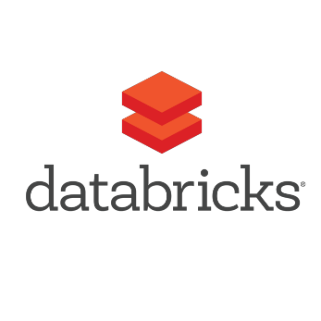



Data Lake Use Cases
Big data clusters
SQL-on-Hadoop solutions
Integrate with open source projects such as Hive, Spark, Storm, Kafka, etc.
Sandbox solutions for initial data prep, experimentation, and analysis
Migrate from proof of concept to operationalized solution
Data Science Experimentation | Hadoop Integration
Hadoop
Spatial, GPS
Data Lake
Devices & Sensors
Machine Learning
Advanced Analytics
Raw Data
Curated Data
Social Media Data
Data Science Sandbox
Exploratory Analysis
Analytics & Reporting
Flat Files

Slide 7


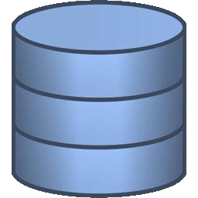


Data Lake Use Cases
Data Warehouse Staging Area
ELT strategy
(extract>load>transform)
Reduce storage needs in relational platform by using the data lake as landing area
Practical use for data stored in the data lake
Potentially also handle data transformations in the data lake
Cloud Systems
Data Lake
Devices & Sensors
Raw Data: Staging Area
Cubes & Semantic Models
Data Warehouse
Social Media Data
Data Processing Jobs
Third Party Data, Flat Files
Analytics & Reporting
Corporate Data

Slide 8
Data Lake Use Cases
Active Archiving
Offload aged data from data warehouse back to the data lake
An “active archive” available for querying when needed
Federated queries to access:
current data in the DW + archive data in the data lake
Cloud Systems
Data Lake
Devices & Sensors
Raw Data: Staging Area
Cubes & Semantic Models
Data Warehouse
Social Media Data
Third Party Data, Flat Files
Archived Data
Analytics & Reporting
Corporate Data

Slide 9



Data Lake Use Cases
Lambda Architecture
Support for low-latency, high-velocity data in near real time
Support for batch- oriented operations
Serving Layer
Speed Layer
Devices & Sensors
Data Ingestion
Data Processing
Near Real-Time
Batch Layer
Cubes & Semantic Models
Social Media Data
Data Lake: Raw Data
Data Lake: Curated Data
Data Warehouse
Analytics & Reporting
Corporate Data

Slide 10
Big Data in Azure

Slide 11






Big Data in Azure
Compute | Azure HDInsight | Azure Databricks | Azure Data Lake Analytics | Hadoop on a cluster of Azure virtual machines (IaaS)
Storage | Azure Storage | Azure Data Lake Storage (Gen1) | Azure Data Lake Storage (Gen2)*
*In Public Preview

Slide 12

Azure Data Lake
Azure Data Lake is a collection of the following services:
Compute
Azure HDInsight
Clusters as-a-service
Azure
Data Lake Analytics
Queries as-a-service
Storage
Azure Data Lake Storage (Gen1)
Storage-as-a-service
Azure Data Lake Storage (Gen2)*
*In Public Preview

Slide 13
Data Storage in Azure

Slide 14
Big Data in Azure: Storage
(Excluding relational and NoSQL data storage options)
Optimized for analytics workloads
Azure Data Lake Storage (Gen1)
Azure Data Lake Storage (Gen2)*
General purpose files & workloads
Azure Storage
Object storage
Hierarchical file system
Multi-modal storage
*In Public Preview

Slide 15



Azure Storage
Storage Account
Object-based storage manages data as discrete units.
Folders are part of the URI, but they’re merely simulated.
There is no folder- level security, nor
folder-specific performance optimizations.
Container
Blob(s)
‘CustomerATMTransactions_201808_1.csv’
‘CustomerATMTransactions_201808_2.csv’
‘CustomerATMTransactions_201808_3.csv’
Container
Container

Slide 16





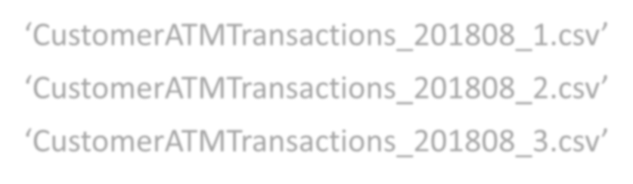

Azure Data Lake Storage Gen 1
Hierarchical
file-based storage supports nesting of files within folders.
Folder-level security can be implemented, as well as certain performance optimizations.
ATMMachineData
Raw
2018
08
‘CustomerATMTransactions_201808_1.csv’
‘CustomerATMTransactions_201808_2.csv’ ‘CustomerATMTransactions_201808_3.csv’

Slide 17
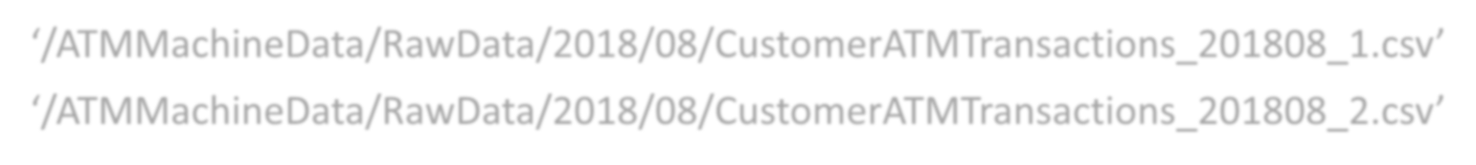




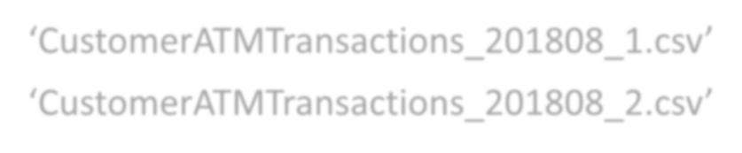

Previously – An Either/Or Decision
Object store
‘/ATMMachineData/RawData/2018/08/CustomerATMTransactions_201808_1.csv’
‘/ATMMachineData/RawData/2018/08/CustomerATMTransactions_201808_2.csv’
Azure Storage
­OR­
Hierarchical storage
ATMMachineData
Azure Data Lake
Storage Gen 1
Raw
2018
08
‘CustomerATMTransactions_201808_1.csv’
‘CustomerATMTransactions_201808_2.csv’

Slide 18











Deciding Between Storage Services
Azure Storage
ADLS (Gen 1)
General purpose object store (containers > blobs)
Addtitional features not available in ADLS Gen1
Data replication and redundancy options
Available in all regions globally
Hot/cold/archive tiers
Lifecycle management (in preview at this time)
Metadata (key/value pairs)
Hierarchical file system (folders > files)
Optimized for analytics workloads
Hadoop and big data optimizations
Parallelized reads and writes
Scaled out over multiple nodes
Low latency writes with I/O throughput
Fine-grained security via access control lists
ADLS (Gen 2)
Multi-modal combining features from both of the above
Not a separate service: Azure Storage with new features
Enable the “hierarchical namespace” (HNS) to use

Slide 19





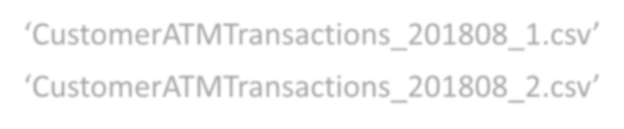






New Multi-Modal Storage Option: ADLS Gen 2
The long-term vision:
The data is stored once, and accessed through either endpoint based on use case / data access pattern. Files & folders are ‘first class citizens.’
ATM Machine
Data
Azure Data Lake Storage Gen 2
Raw
2018
08
‘CustomerATMTransactions_201808_1.csv’
‘CustomerATMTransactions_201808_2.csv’
Endpoint:
Endpoint:
object store access
file system access

Slide 20





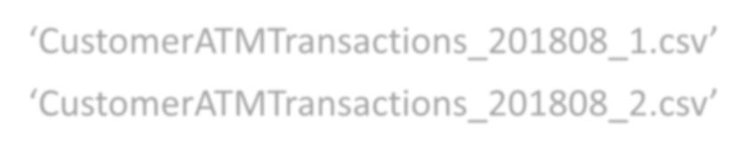



Object Store Endpoint: wasb[s]
ATM Machine
Data
Raw
2018
08
‘CustomerATMTransactions_201808_1.csv’
‘CustomerATMTransactions_201808_2.csv’
Endpoint:
object store access
wasb[s]://containername@accountname.blob.core.windows.net/raw/2018/08/CustomerATMTransactions_2018_1.csv

Slide 21




File System Endpoint: abfs[s]
ATM Machine
Data
Raw
2018
08
‘CustomerATMTransactions_201808_1.csv’
‘CustomerATMTransactions_201808_2.csv’
Endpoint:
file system access
afbs = Azure Blob File System
abfs[s]://filesystemname@accountname.dfs.core.windows.net/raw/2018/08/CustomerATMTransactions_2018_1.csv
afbs is the driver abfss = SSL
dfs is the endpoint

Slide 22











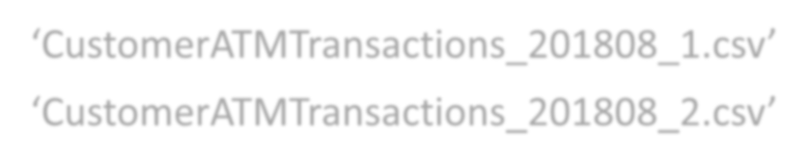

Multi-Modal Advantages with ADLS Gen 2 – Example 1
Leverage partition scans & partition pruning to improve query performance:
Raw
Security at the folder level
2018
Endpoint: file system access
Queries
01
Select… From… Where Month=01
02
…
08
‘CustomerATMTransactions_201808_1.csv’
‘CustomerATMTransactions_201808_2.csv’

Slide 23


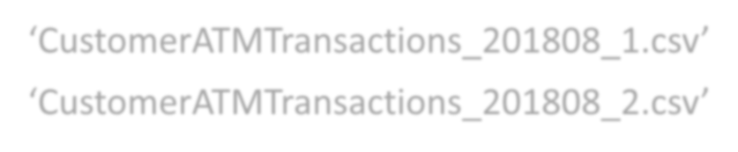









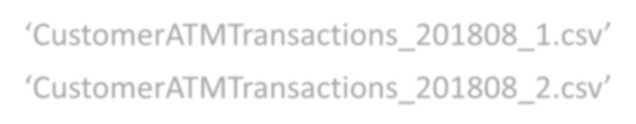
Multi-Modal Advantages with ADLS Gen 2 – Example 2
Metadata­only changes with significantly better performance using the file system endpoint:
‘CustomerATMTransactions_201808_1.csv’ ‘CustomerATMTransactions_201808_2.csv’
Raw
Current status: This scenario is supported if everything uses file system endpoint – full interoperabililty is still evolving
Data ingestion
Temp
Endpoint of
choice: object store access -or- file system access
Raw
2018
Data processing
Endpoint: file system access
08
‘CustomerATMTransactions_201808_1.csv’
‘CustomerATMTransactions_201808_2.csv’

Slide 24



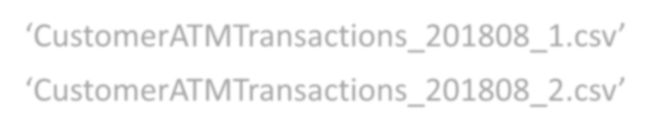









Multi-Modal Advantages with ADLS Gen 2 – Example 3
Use different endpoints for ingestion vs. data processing:
Current status: This is the vision from the product team, but using both interchangeably is not yet supported
Raw
2018
Data ingestion
08
‘CustomerATMTransactions_201808_1.csv’
‘CustomerATMTransactions_201808_2.csv’
Endpoint: object store
access
Data processing
Curated
Endpoint: file system access
‘CustomerATMTransactionsSummary.csv’

Slide 25























Multi-Modal Advantages with ADLS Gen 2 – Example 4
Use as the basis for Dataflows in Power BI:
Power BI Service
ADLS Gen 2
Dataflow
Power Query Online
CDM source/subject
Data Source
‘CustomerEntity.csv’
Dataset
‘ProductEntity.csv’
CDM­compliant tables in ADLS Gen 2
Report(s)
Current status:
Dataset
Both services
are in public
Azure Data Factory
Azure Machine Learning
Azure Databricks
preview so capabilities are evolving
Report(s)
CDM = Common Data Model

Slide 26






Azure Data Lake Storage Gen 2
ADLS Gen 2: File System
=
Azure Storage: Container
ADLS Gen 2 =
Azure Storage with the Hierarchical Namespace (HNS) enabled.
Storage Account
File System
Folders & Files
Hierarchical Namespace
Object store drivers
File system drivers
Adapted from: https://azure.microsoft.com
/en-us/blog/a-closer-look- at-azure-data-lake- storage-gen2/
Endpoint: object store access Blob API using wasb[s]://
Endpoint: file system access ADLS Gen 2 API using abfs[s]://

Slide 27

When to **Disable** the Hierarchical Namespace?
General purpose file storage such as backups and VHDs
Classic object store use cases which do not benefit from hierarchical storage or a high degree of organization (ex: image storage)
Custom apps, APIs, or legacy systems which only use the Blob API and/or are unaware of file system semantics
The HNS is enabled at the storage account level.
Product team says there’s no harm or performance difference (even for raw I/O) if the HNS is enabled but not used.
However, you’ll pay extra cost (~30% extra) on every transaction if HNS is enabled.

Slide 28
Summary: Goals of ADLS Gen 2
Unify the data lake story on Azure
Take advantage of the best of both feature sets (object storage & hierarchical storage)
Multiple protocol endpoints to allow flexibility for use cases
Avoid duplicating data for specific use cases or tools (‘islands of data’)
Overcome limitations of object storage (ex: metadata only operations)
Improved performance for big data analytics
Implement full data lifecycle and data policies
Low cost with high-performing throughput
Integrate with the new ‘dataflows’ functionality in Power BI

Slide 29







Summary: Current State of the Storage Options
Azure Storage
ADLS (Gen 1)
Still a very valid option for object store workloads
Fully supported in existing regions
No new features
ADLS (Gen 2)
In public preview
Feature support is evolving over time

Slide 30
Compute in Azure

Slide 31








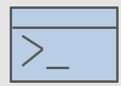


Compute Services and Data Management
Cloud Systems
Data Lake Storage
Azure Portal
Visual Studio Code
Visual
Azure
Azure Storage Explorer
Devices & Sensors
Studio Data
Extensions Factory
Social Media Data
Azure PowerShell
Azure Cloud Shell
Azure SDKs (.NET, Java,
Node.js, Python, etc)
Azure CLI
Azure Mobile App
Azure Data Lake Analytics
Third Party Data, Flat Files
Azure Databricks
HDInsight
Corporate Data
*In Public Preview

Slide 32
Big Data in Azure: Compute
Higher level of complexity, control, & customization
Easiest entry point to get started
Less administrative effort
Azure
Data Lake Analytics (Serverless)
Azure Databricks (PaaS)
Azure HDInsight (PaaS)
Hadoop on a cluster of Azure virtual machines (IaaS)
Greater administrative effort
Greater integration with various Apache projects
Less integration with various Apache
projects

Slide 33






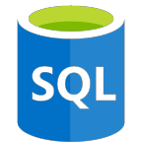
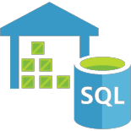

Azure Data Lake Analytics
Built-In Extensibility
Built-In U-SQL Extensions
Azure Data Lake Analytics
Python
Cognitive Services
U-SQL Job Processing
R
Cloud Systems
Azure Data Lake Storage
Job 1
Job 2
Create, Execute U-SQL Jobs & Manage Resources
Devices & Sensors
Azure Portal
Visual
Visual
Azure
Studio Studio Data Code Extension Factory
Social Media Data
ADLA Catalog
Database
Azure Azure PowerShell Cloud
Shell
Azure Azure SDKs CLI
Tables
Procedures
External Data Sources
Third Party Data, Flat Files
Views
Functions
Distributed U-SQL Queries
HDInsight
Azure Blob Storage
Schemas
Assemblies
Azure SQL DB
Azure SQL DW
SQL Server in Azure VM
Corporate Data
Azure Databricks
Database

Slide 34
U-SQL: Unified SQL
Blends the declarative nature of SQL dialects + imperative nature of C#.
Works on structured as well as semi-structured data without reformatting. Distributed query support which scales and parallelizes across nodes.
Azure Data Lake Analytics
Cloud Systems
Devices & Sensors
Azure Data Lake Storage
Supported:
Batch processing queries
File output to ADLS
Gen 1 or Blob Storage
U-SQL Job Processing
Social Media Data
Job 1
Job 2
Third Party Data, Flat Files
Job 3
Current status: No integration with
ADLS Gen 2 at this time (it requires the flat object store endpoint)
Corporate Data
Azure Blob Storage

Slide 35

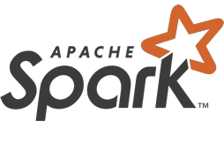






Azure Databricks
A unified platform for data engineering and data science activities
Cloud Systems
Azure Machine Learning
Azure Cognitive Services
Devices & Sensors
Azure Databricks
Azure Data Lake Storage
SQL
Azure Data Factory
Social Media Data
Third Party Data, Flat Files
Azure SQL DB
Azure CosmosDB
Azure Blob Storage
Corporate Data
Azure
SQL Server in _{SQL DW}
Azure VM

Slide 36





Azure HDInsight
Managed big data clusters for running open source frameworks
Cloud Systems
Azure Machine Learning
Azure Cognitive Services
Devices & Sensors
Azure HDInsight
Azure Data Lake Storage
Azure Data Factory
Social Media Data
Third Party Data, Flat Files
Azure SQL DB
Azure CosmosDB
Azure Blob Storage
Corporate Data
Azure
SQL Server in _{SQL DW}
Azure VM

Slide 37








Deciding Between Compute Services
Hadoop VM
HDInsight
Databricks
ADLA
Type:
IaaS
Running your own cluster of Hadoop virtual machines
Full control over everything; investment in distributions such as Hortonworks, Cloudera, MapR
PaaS
Running a managed big data cluster
Integration with open source Apache projects and/or greater control over clusters
PaaS
Serverless
Purpose:
Running a managed, Running U-SQL
optimized Spark framework
Collaborative notebooks; easier deployments; utilizing Spark in a variety of ways
1st choice
batch jobs
Suitable for:
Focus on running individual jobs (scripts) rather than managing a cluster
Caution

Slide 38








Interacting with ADLS Gen 2
SparkSQL
Hadoop Kafka
R
HBase
DataFrames
Azure Data Lake Analytics
Hive LLAP
Spark
Storm
MLlib
Custom apps, APIs, legacy systems
Azure HDInsight
GraphX
SparkR
Windows
Azure Blob File System Driver (abfs[s]:\\)
Azure Storage Blob Driver (wasb:\\)
Azure Databricks
Azure Data Factory
Current status:
REST API interface
Blob endpoint
Azure Data Lake Storage (Gen 2)*
Azure Storage Explorer
is disabled
File (Blob)
*In Public Preview

Slide 39
Integrating Azure
Data Lake in a
Multi-Platform Architecture

Slide 40



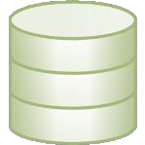



Multi-Platform Architecture
Handle a variety of data types & sources
Larger data volumes at lower latency
Bimodal: self-service + corporate BI to support all types of users
Newer cloud services
Advanced analytics scenarios
Balance data integration & data virtualization
Alerts Near Real­Time Monitoring
Devices & Sensors
Data Lake
Social Media Data
Advanced Analytics
Data Integration
Data Virtualization
Machine Learning
Cloud Systems
Hadoop
NoSQL
ODS
Operational Reporting
Corporate Data
Analytics & Reporting
Batch ETL
Historical Analytics
Cubes & Semantic Models
In-Memory Models
Third Party Data
Data Warehouse
Data Marts
Self­Service
Reports & Models
Master Data

Slide 41
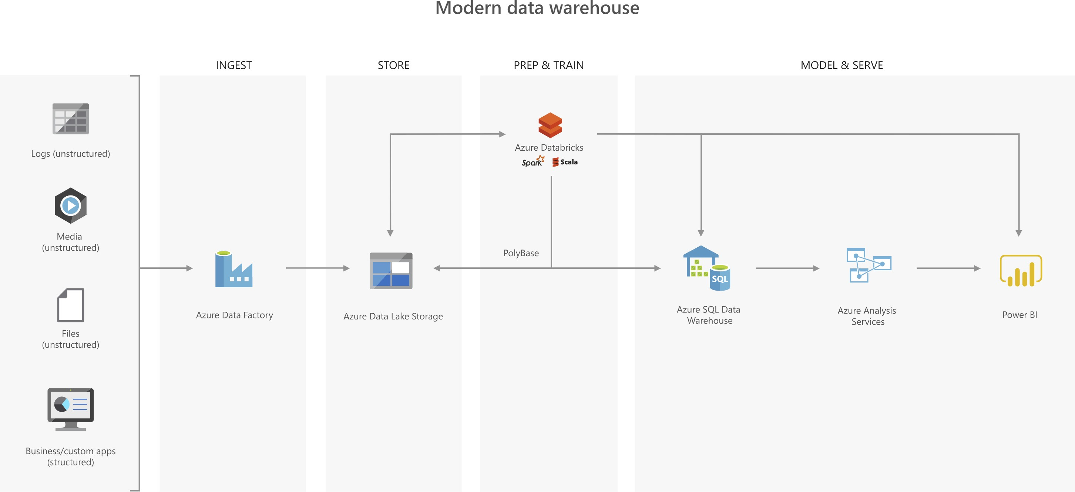
Azure Data Lake Implementation Options
Source: https://azure.microsoft.com/en-us/services/storage/data-lake-storage/

Slide 42
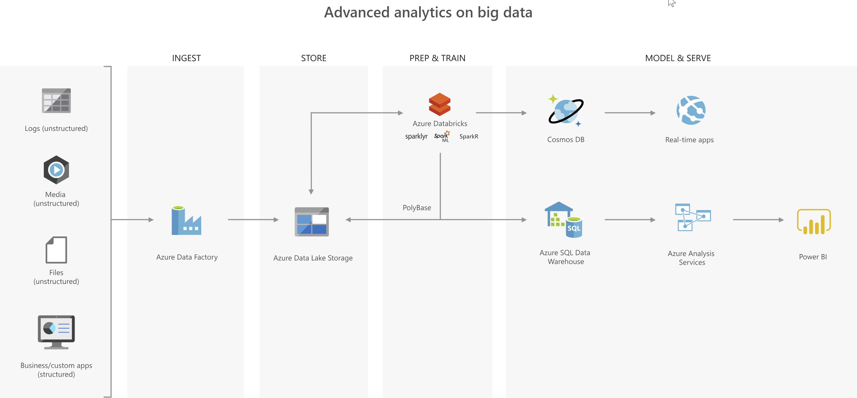
Azure Data Lake Implementation Options
Source: https://azure.microsoft.com/en-us/services/storage/data-lake-storage/

Slide 43
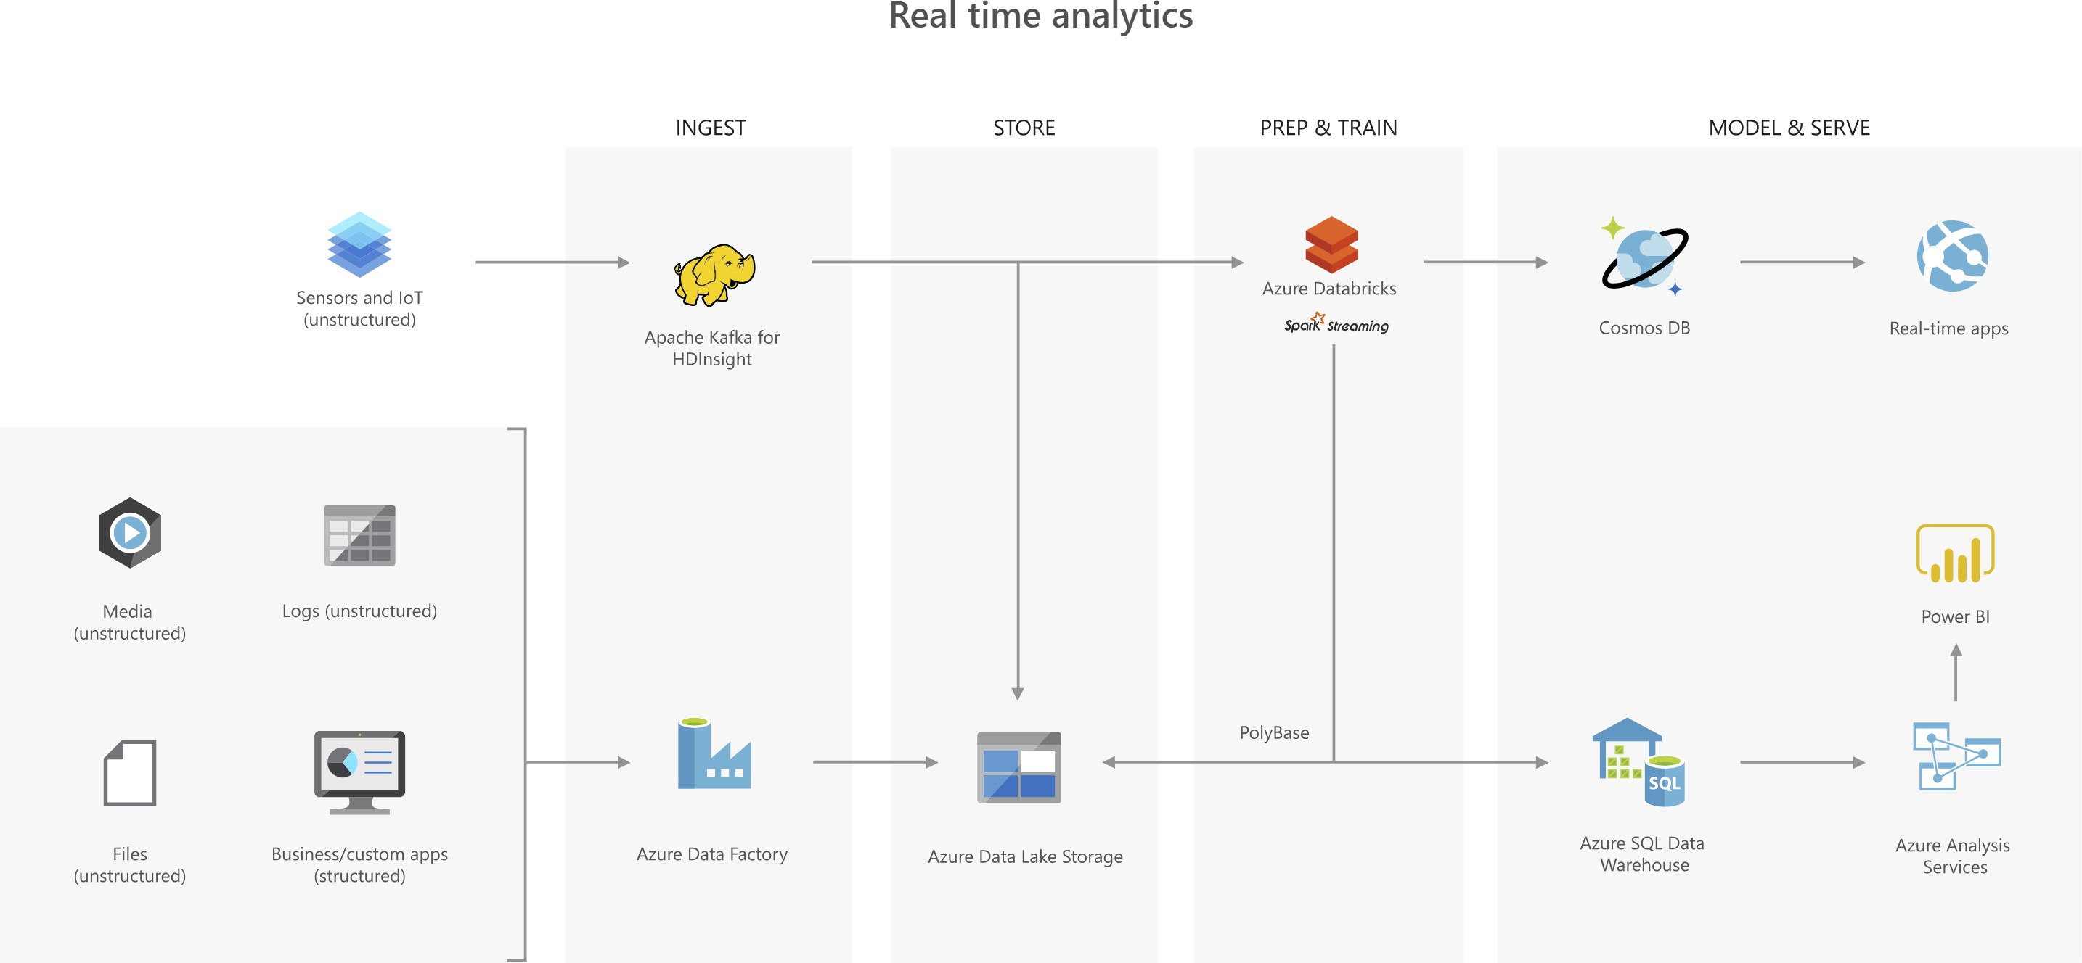
Azure Data Lake Implementation Options
Source: https://azure.microsoft.com/en-us/services/storage/data-lake-storage/

Slide 44
Suggestions for
Getting Started with a Data Lake Project

Slide 45
Getting Started With a Data Lake Project
Is a Data Lake the Right Choice?
Various data types, various sources,
Do you have non-relational data?
Do you have IoT type of data?
whether it’s “big data” or not
Streaming or micro­batch pipelines
Do you have advanced analytics scenarios on unusual datasets?
Do you need to offload ETL processing (ELT)and/or archive data from a data warehouse or other systems to low-cost storage?
Readiness:
Are you ready willing to learn different development patterns and/or new technologies? Are you ready to handle the trade-offs of ‘schema on read’ vs ‘schema on write’?

Slide 46
Getting Started With a Data Lake Project
Data
What types of data ingestion pipelines do you have, at what frequency?
Batch
Micro-batch
Streaming
What are the current + anticipated data size volumes, and in what format?
Structured data
The data itself influences
Semi-structured data
Unstructured data
Geospatial data
how simple or complicated an architecture can get
To what extent does semi-structured data need to be integrated with the structured data?

Slide 47
Getting Started With a Data Lake Project
Data Movement & Storage
What level of data integration (ETL or ELT) vs. data virtualization provides optimal data access?
Data movement can be expensive
Data might be too large to practically move
Time window for data processing may be small
Latency (freshness) of data varies
How much data movement are you willing to do?
A multi­platform architecture is more appealing if you subscribe to a polyglot persistence strategy. Success very much depends on staff skills.
Which do you value more?
Polyglot persistence strategy (“best fit engineering”)
Architectural simplicity

Slide 48
Getting Started With a Data Lake Project
Information Delivery
The user base translates into
expectations for how the information is to be delivered, which translates into technology choices
What are the expectations + needs of your user population?
Casual users
Data analysts
Data scientists
IT, BI specialists, big data engineers
What type of data consumption do you support?
Centralized reporting & analytics
Decentralized self-service models
Departmental or subject-specific data marts
Application integration
The more diverse your user population is, the more likely you will have a multi­ platform architecture with both schema­on­read and schema­on­write

Slide 49
Getting Started With a Data Lake Project
Organizing the Data Lake
Based on optimal data retrieval & security boundaries
Avoid a chaotic, unorganized data swamp
Take advantage of data pruning optimizations (esp year/month/day) when running queries
Common ways to organize and/or tag the data:
Time Partitioning
Year/Month/Day/Hour/Minute
Data Retention Policy
Temporary data Permanent data
Applicable period (ex: project lifetime) etc…
Probability of Data Access
Recent/current data Historical data
etc…
Subject Area
Security Boundaries
Department Business unit
etc…
Business Impact / Criticality
High (HBI) Medium (MBI) Low (LBI)
etc…
Confidential Classification
Public information Internal use only
Supplier/partner confidential Personally identifiable information (PII) Sensitive – financial
Sensitive – intellectual property etc…
Downstream App/Purpose
Owner / Steward / SME

Slide 50









































Getting Started With a Data Lake Project
Organizing the Data Lake
Although a data lake emphasizes getting started quickly, there is still up-front planning
Data Lake
Archive Data
Raw Data
Staged Data
Data
Warehouse
Analytics Sandbox
Exploratory Analysis
& Data Science
Curated Data
Standardized
Raw Data
Big Data Analytics
Transient/Temp
Master Data
Operationalized Data Science
User Drop Zone
Analytics & Reporting
Metadata | Security | Governance | Information Management

Slide 51
Getting Started With a Data Lake Project
Data Lake Challenges
Technology
Process
People
Data
Complex, multi­layered architecture
Unknown storage & scalability
Data retrieval
Working with un­ curated data
Performance
Change management
Evolving, maturing tech
Expectations & trust
Data stewardship
Redundant effort
Data engineering skillsets
Ownership changes between teams to operationalize solutions
Data volumes
Read & write performance
Relating disparate data
Schema changes over time
Diversity of file formats & types
Right balance of deferred work vs. up­front work to minimize chaos
Ignoring established best practices for data mgmt
Data quality
Governance
Security
Disaster recovery for large solutions

Slide 52

Getting Started With a Data Lake Project
Always do a proof of concept before making a big commitment, including file management, data access & security.
Data tagging & cataloging is critical. Capture metadata whenever possible.
Consider the experience level of your staff, and the ability to support a complex solution.
Assess the impact of open source technologies vs. proprietary technologies.

Slide 53
Getting Started With a Data Lake Project
Cloud offerings/features/functionality are constantly changing. It is very challenging to keep up.
Your goals for going to the cloud will consistently involve trade- offs: cost, complexity, security.
Though traditional data warehousing is evolving, the concept of curated, cleansed, user-friendly data structures are still extremely relevant & needed.

Slide 54
Getting Started With a Data Lake Project
Organize data by time series whenever possible.
Consider data access patterns when designing the folder structure. “Pruning” of data can happen when data is set up in a well- designed hierarchy.
Make careful decisions about file formats you select. Every format has tradeoffs. File sizes:
oThere is a 4.77 TB file limit in Gen 2 (there was no specific file limit in Gen1).
oThe traditional Hadoop ‘small file size’ problem still exists (though technology is evolving to help).
oThe ideal, practical file size is still ~250MB - ~2GB.

Slide 55
Appendix A Suggestions for Continued Learning

Slide 56
Suggestions for Continued Learning
(1/4)
Azure Data Lake Developer Center: http://azure.github.io/AzureDataLake/ ←tons of helpful links U­SQL Center: http://usql.io/
U­SQL Tutorial: https://saveenr.gitbooks.io/usql­tutorial/content/
Azure Data Lake Samples & Documentation: https://github.com/Azure/AzureDataLake/ U­SQL Samples & Documentation: https://github.com/Azure/USQL
Azure Data Lake Release Notes: https://github.com/Azure/AzureDataLake/tree/master/docs/Release_Notes Contains new features, fixes, deprecations, and breaking changes
Azure Data Lake Team Blog: https://blogs.msdn.microsoft.com/azuredatalake/
Azure Data Lake Extensions for Visual Studio: https://www.microsoft.com/en­us/download/details.aspx?id=49504 Azure Data Lake Course from Microsoft Virtual Academy: https://mva.microsoft.com/en­US/training­
courses/introducing­azure­data­lake­17795?l=SugmcFt9D_3111787171 ←highly recommended
ADL Twitter account: https://twitter.com/azuredatalake
ADL team member Twitter accounts: https://twitter.com/MikeDoesBigData + https://twitter.com/saveenr

Slide 57
Suggestions for Continued Learning
(2/4)
ADLS Best Practices: https://docs.microsoft.com/en­us/azure/data­lake­store/data­lake­store­best­practices
ADLS Performance Tuning Guidance: https://docs.microsoft.com/en­us/azure/data­lake­store/data­lake­store­performance­tuning­guidance
ADLA Saving Money & Controlling Costs:
https://onedrive.live.com/?authkey=%21AHceDeuGX5PKbVw&id=3BDE3286AB2E59F7%211005&cid=3BDE3286AB2E59F7
Azure Data Architecture Guide: https://docs.microsoft.com/en­us/azure/architecture/data­guide/
Creating External Data Sources for PolyBase and Elastic Queries: https://docs.microsoft.com/en­us/sql/t­sql/statements/create­external­
data­source­transact­sql
Azure Big Data Blog: https://azure.microsoft.com/en­us/blog/topics/big­data/

Slide 58
Suggestions for Continued Learning
(3/4)
Blog Posts
Querying Data in Azure Data Lake Store with Power BI:
https://www.sqlchick.com/entries/2018/5/6/querying­data­in­azure­data­lake­store­with­power­bi
Zones in a Data Lake: https://www.sqlchick.com/entries/2017/12/30/zones­in­a­data­lake
Granting Permissions in Azure Data Lake: https://www.sqlchick.com/entries/2018/3/16/granting­permissions­azure­data­lake
Running U­SQL on a Schedule with Azure Data Factory to Populate Azure Data Lake:
https://www.sqlchick.com/entries/2017/10/8/running­u­sql­on­a­schedule­with­azure­data­factory
Querying Multi­Structured JSON Files with U­SQL in Azure Data Lake: https://www.sqlchick.com/entries/2017/9/4/querying­multi­
structured­json­files­with­u­sql­in­azure­data­lake
Handling Row Headers in U­SQL: https://www.sqlchick.com/entries/2017/7/27/handling­row­headers­in­u­sql
Two Ways to Approach Federated Queries with U­SQL and ADLA:
https://www.sqlchick.com/entries/2017/10/29/two­ways­to­approach­federated­queries­with­u­sql­and­azure­data­lake­analytics

Slide 59
Suggestions for Continued Learning
(4/4)
Video
What’s New with Azure Data Lake Storage Gen 2
https://www.youtube.com/watch?v=DJkFSpis2B0
E-Book
Data Lakes in a Modern Data Architecture
https://www.blue­granite.com/data­lakes­in­a­modern­data­architecture­ebook

Slide 60
Appendix B
Terms & Definitions

Slide 61
Definitions
(1/3)
Repository of data from multiple sources, cleansed & enriched for reporting; generally ‘schema on write’
Data Warehouse
Data Lake
Repository of data for multi-structured data; generally ‘schema on read’
Hadoop
Data storage via HDFS (Hadoop Distributed File System), and
Set of Apache projects for data processing and analytics
Lambda Architecture
Data processing & storage with batch, speed, and serving layers
ETL
Extract > Transform > Load: traditional paradigm associated with data warehousing and ‘schema on write’
Extract > Load > Transform: newer paradigm associated with data lakes & ‘schema on read’
User-friendly interface for users on top of a data warehouse and/or data lake
ELT
Semantic Model

Slide 62
Definitions
(2/3)
Data Integration
Physically moving data to integrate multiple sources together
Data Virtualization
Access to one or more distributed data sources without requiring the data to be physically materialized in another data structure
Federated Query
A type of data virtualization: access & consolidate data from multiple distributed data sources
A multi-platform strategy which values using the most effective technology based on the data itself (“best fit engineering”)
Data structure is applied at design time, requiring additional up-front effort to formulate a data model (relational DBs)
Data structure is applied at query time rather than when the data is initially stored (data lakes, NoSQL)
Polyglot Persistence
Schema on Write
Schema on Read
More in­depth definitions: https://www.sqlchick.com/entries/2017/1/9/defining­the­components­of­a­modern­data­warehouse­a­glossary

Slide 63











Definitions
(3/3)
Shared Infrastructure (Lower Cost)
Public Cloud
Azure Functions
Serverless Apps
Easier to Scale
Software as a Service (SaaS)
Platform as a Service
(Paas)
Infrastructure as a Service (IaaS)
Azure SQL DB, Azure SQL DW, Azure HDInsight,
Azure Data Lake Storage
Power BI, Office 365,
Azure Data Lake Analytics
SQL Server in a VM, Hadoop in a VM
On-Premises
Azure Stack (Private Cloud)
Dedicated Infrastructure (Higher Cost of Ownership)
Virtual
Server
Physical
More Difficult to Scale
Server
More Control
(Higher Administration Effort)
Less Control (Lower Administration Effort)

